Slide 1
African Indigenous Healing Systems

Slide 2
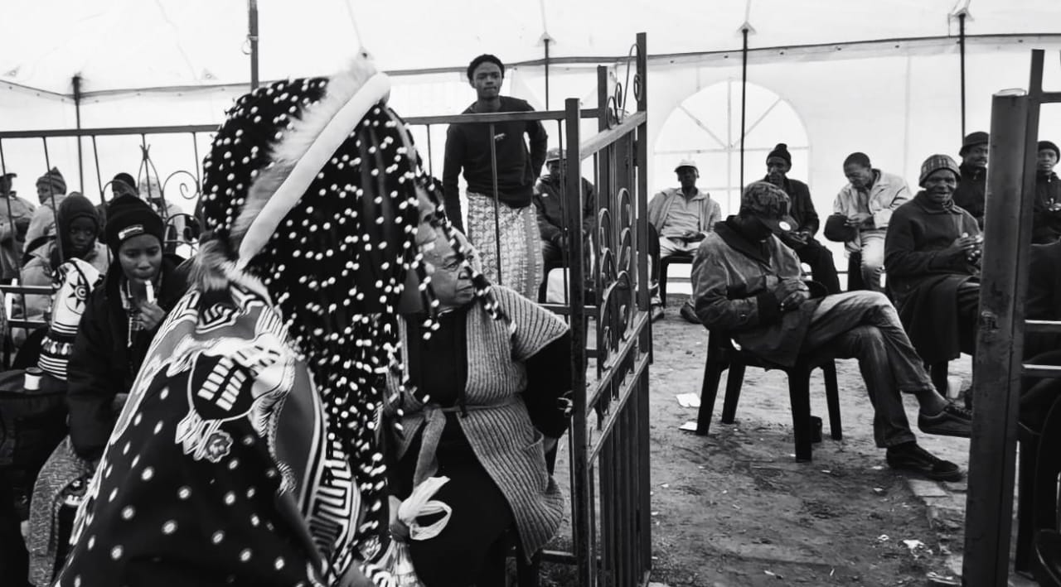
When we speak of Indigenous African Healing, what are we referring to?
Indigenous people are often perceived as primitive and uncivilized. How do we really get to understand the fundamentals of civilisation? If we cannot show reverence for the original peoples, cultures, and way of life, can we truly claim to understand humanity?

Slide 3
Witchcraft Suppression Act 3 Of 1957
The Witchcraft Suppression Act 3 of 1957 is an act of the Parliament of South Africa.
As a result of this act, indigenous people were no longer permitted to carry out indigenous ways of healing as it was considered taboo and unlawful.
It then resulted in the indigenous people following Christian religious practices which largely mirrored their indigenous ways of healing in what was perceived to be just and godly.

Slide 4
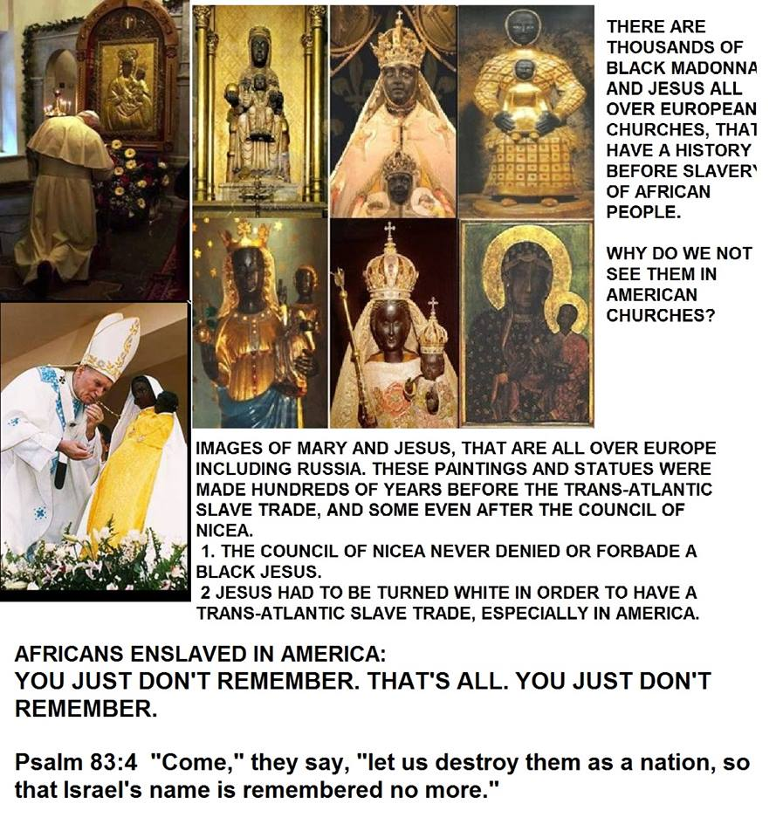
African Indigenous Healing influences on Christianity
Here are a few practices of African Spirituality that were carried out by Yeshuwa, His Disciples and the early Jews:
Yeshuwa was not a Christian. Followers of Yeshuwa are titled Christians because we follow the teachings of the bible, which is the foundation of the Christian religion taught to us by European Missionaries and Ethiopian Orthodox Christians.

Slide 5
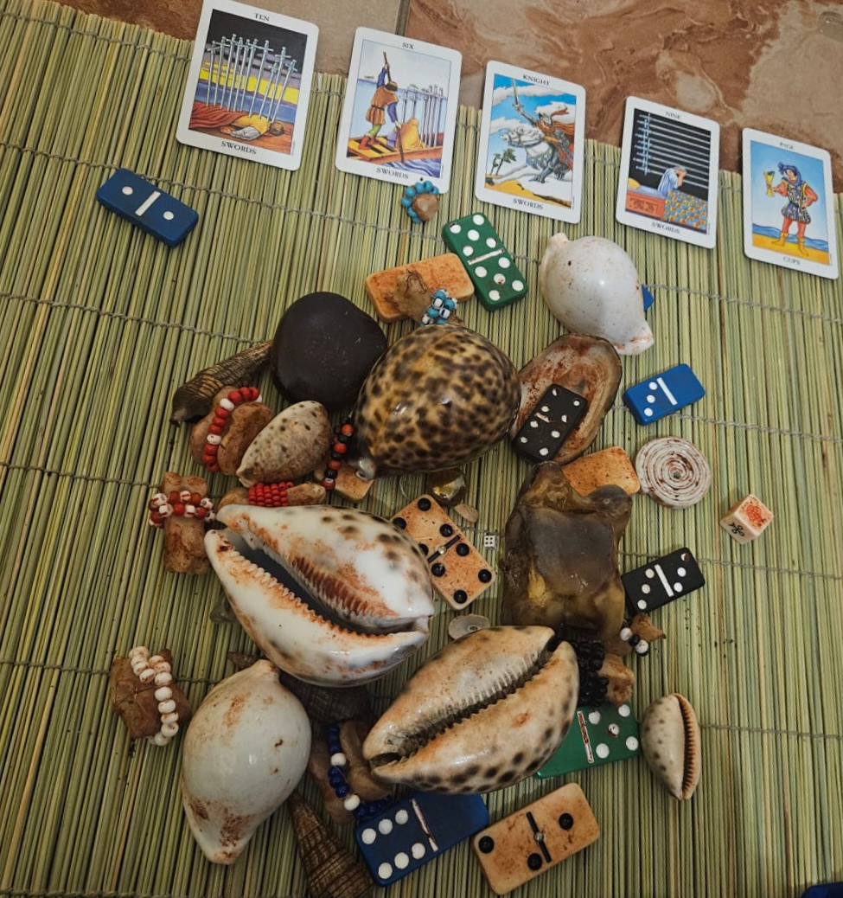
1. Casting of Lots (Throwing of Bones)
This was a practice used to throw lots (sticks, stones, or shells) to determine the will of God; in an effort to receive answers to questions which could not be attained in the physical realm. As the lots were cast, God (higher power) would determine how the lots would fall on the ground; which was an answer that was interpreted by the Priest (healer) to the person seeking answers from God.
Proverbs 16:33 / Acts 1:26 / Psalm 22:18

Slide 6
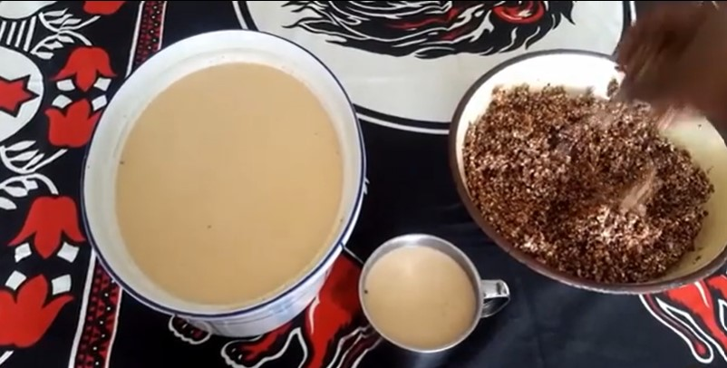
2. Rituals
Customary practices that are carried out for spiritual purposes. Common rituals carried out by Christians are baptism and communion (drinking of the blood and eating of the body of Christ) which takes place on a weekly or bi-weekly basis at church.
John 6:53-58

Slide 7
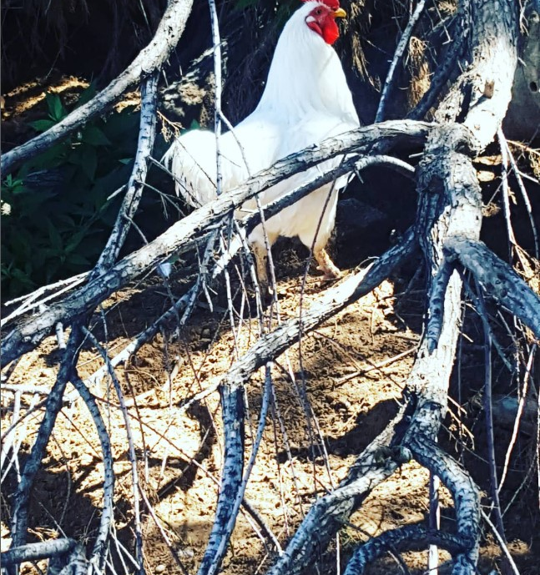
3. Sacrifices
An offering made to God/Ancestors. During biblical times, burnt/sin/repayment/ fellowship and grain offerings were put forward before God on an alter/shrine as a pleasing offering to Him.
1 Chronicles 29:21-25/ Leviticus 1

Slide 8
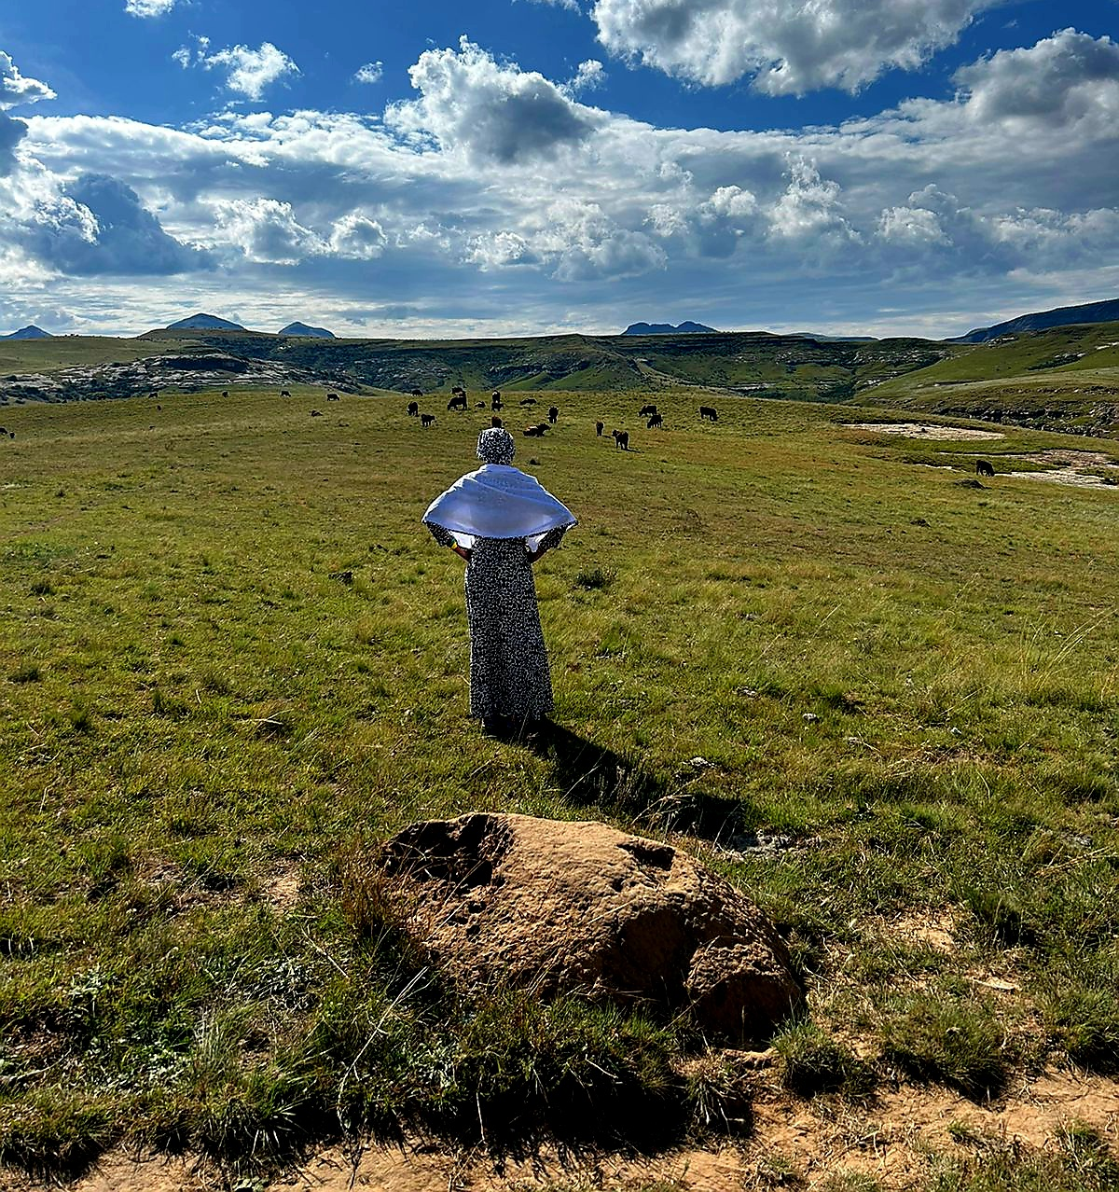
4. Re-incarnation
According to the bible, Yeshuwa acknowledges Elijah the prophet, as John the Baptist; re-incarnated.
Job 1:21 / Malachi 3:1 / Matthew 11:13-14/ Mark 9:13/ Matthew 17:12-13

Slide 9
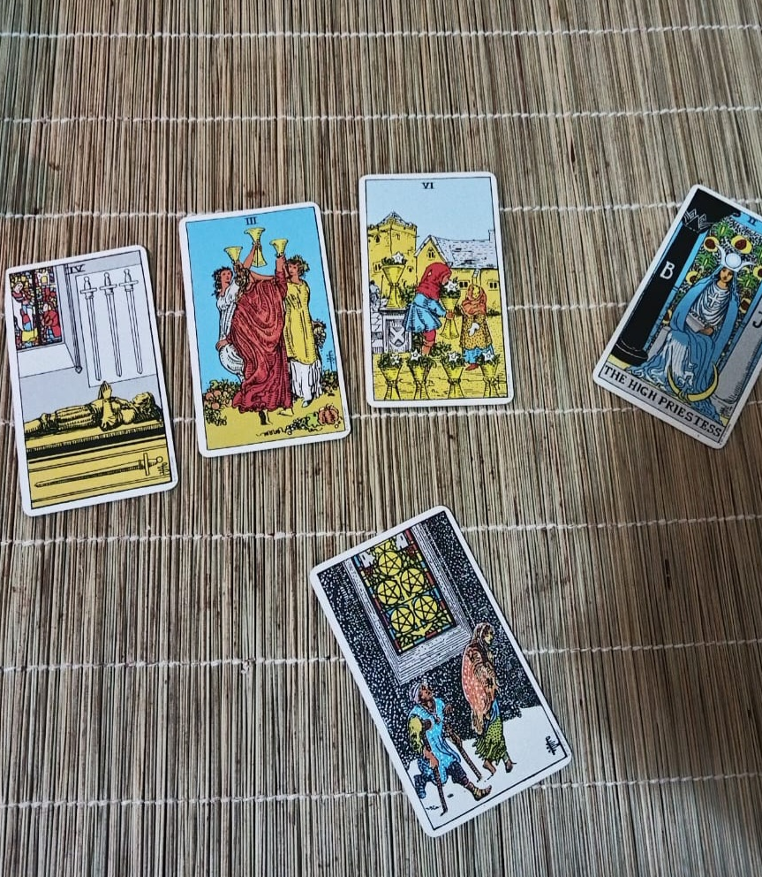
5. Ancestral Divination
This is a sacred moment which establishes a connection with the wisdom of ancestral spirit. In the bible, Angelic communication would take place to impart wisdom and guidance.
1 Samual 3:9/ Ezra 8:20/ Hebrews

Slide 10
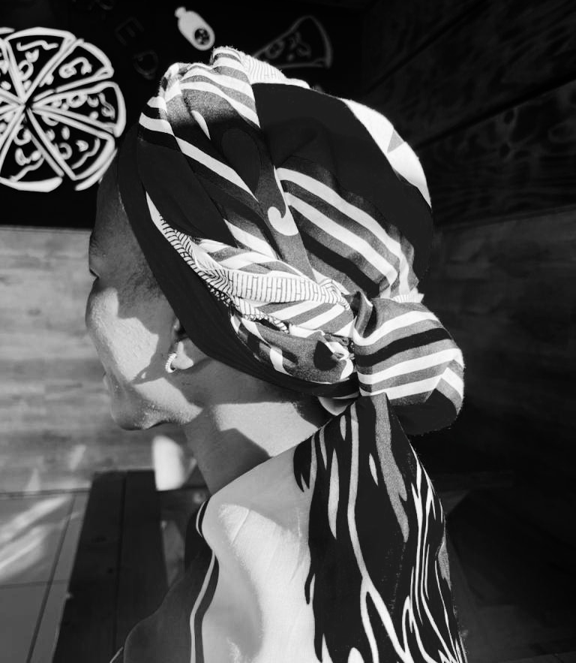
Conclusion
The information I’ve just shared serves no other purpose than to shed light on the misconstrued beliefs on African Spirituality. I encourage every member in the audience to think, probe, analyse, learn, unlearn, and re-learn that which has been taught and otherwise documented about African Spirituality and its influence in the world that we live in today.

Slide 11
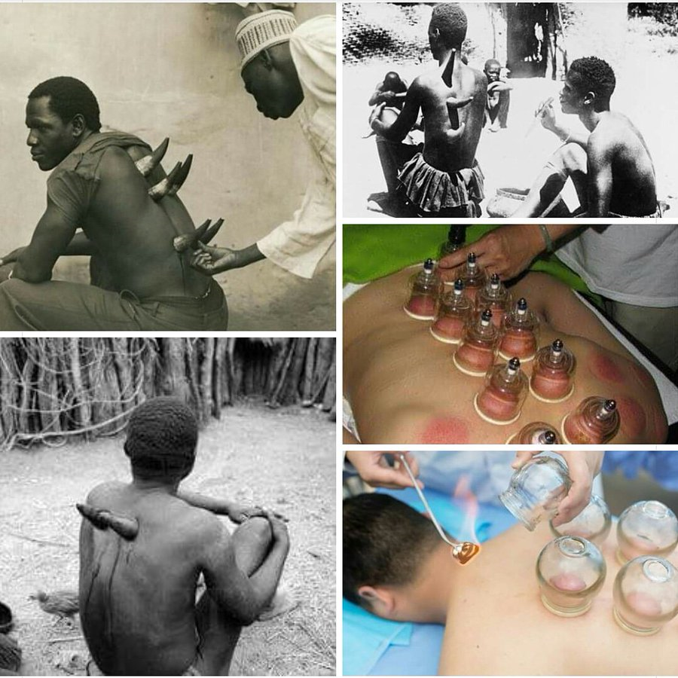
Ancient Medicinal Practices founded on Indigenous Wisdom
Cupping
When African warriors returned home from war, a shaman (healer) would live with them for a period of 3 months to administer indigenous treatments and “cleanse” them of any mental or psychological trauma they might have experienced, as a result of the war. This method of healing had proven to be very effective but was unfortunate lost to colonial practices. Across African communities, a horn was used to draw out stagnant blood to the surface on the skin barrier and remove toxins from the blood.
In today’s era, the suction cup method, globally known as "cupping" is widely known as a Chinese alternative therapy treatment.

Slide 12
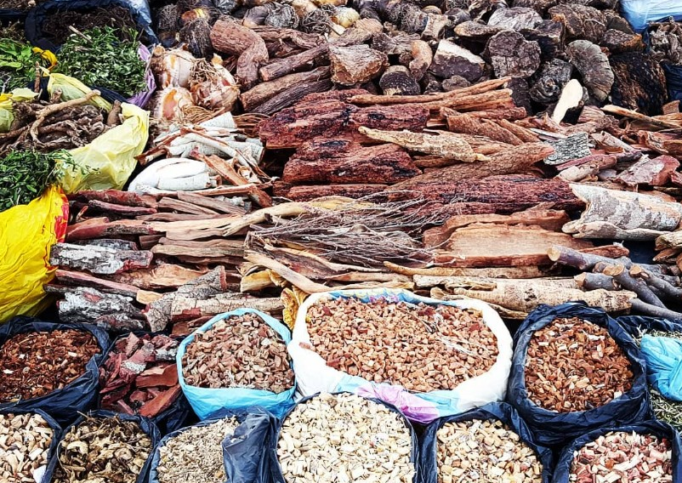
Mental Illness or Spiritual Gift
A few of the markers used to distinguish spiritually gifted individuals
Schizophrenia
Depression & Anxiety
ADHD
Diabetes
HIV
Renal/Kidney Issues
Chronic Migraines
Mobility Challenges
A few of the markers used to distinguish spiritually gifted individuals
Schizophrenia
Depression & Anxiety
ADHD
Diabetes
HIV
Renal/Kidney Issues
Chronic Migraines
Mobility Challenges

Slide 13
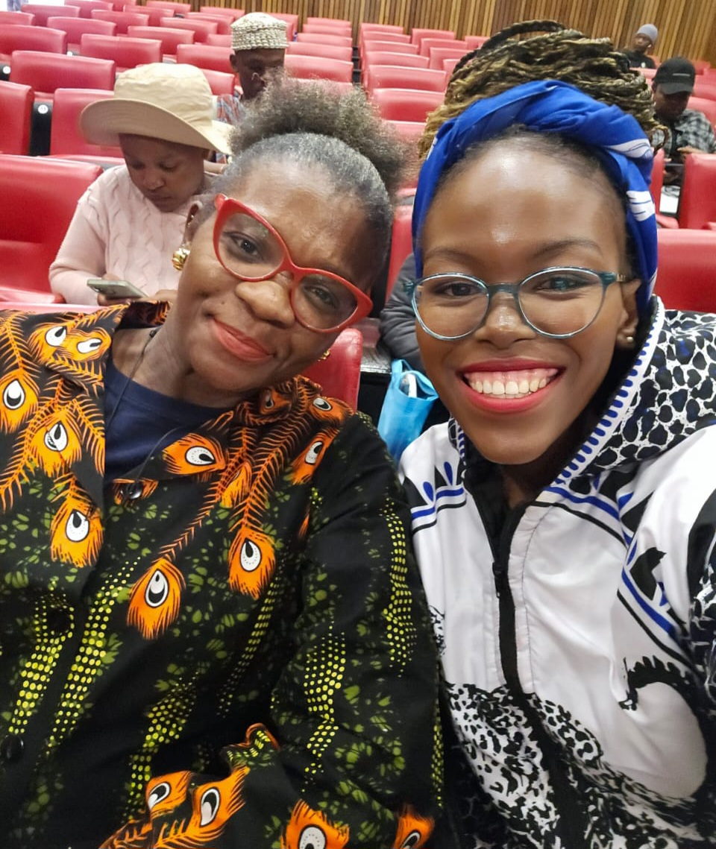
Social Responsibility as Indigenous Healers
Honesty & Authenticity
Transparency
Education
Collaboration

